Slide 1
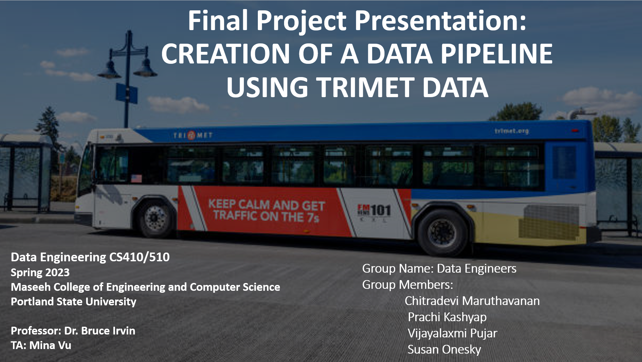

Slide 2
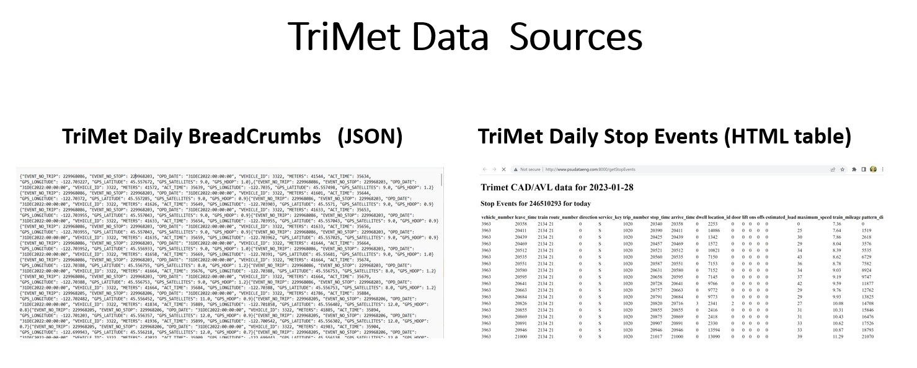

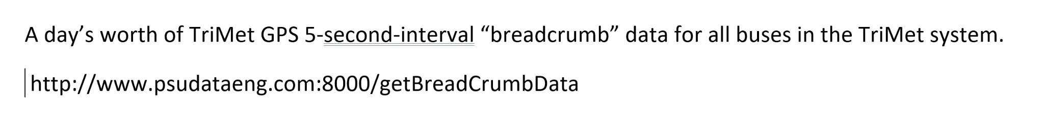
Susan
Notes:
Add links of sources

Slide 3
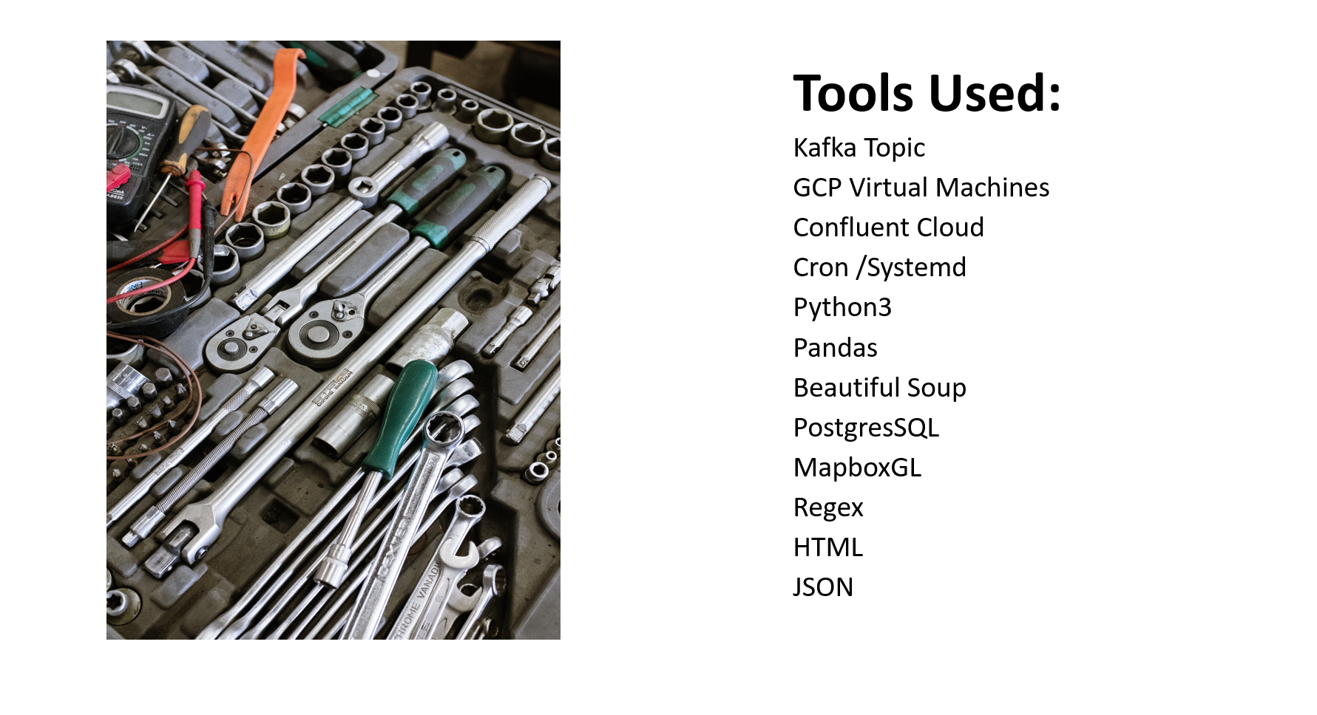
Susan

Slide 4

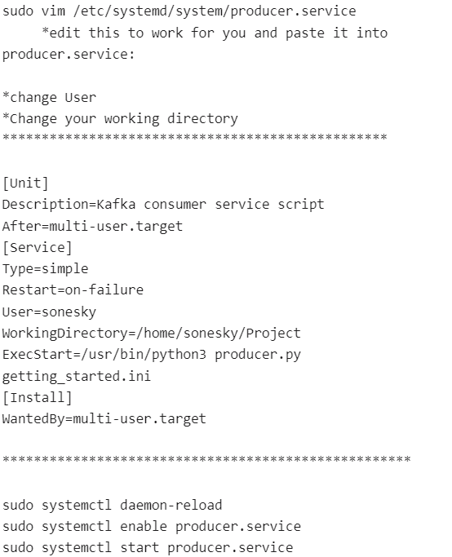

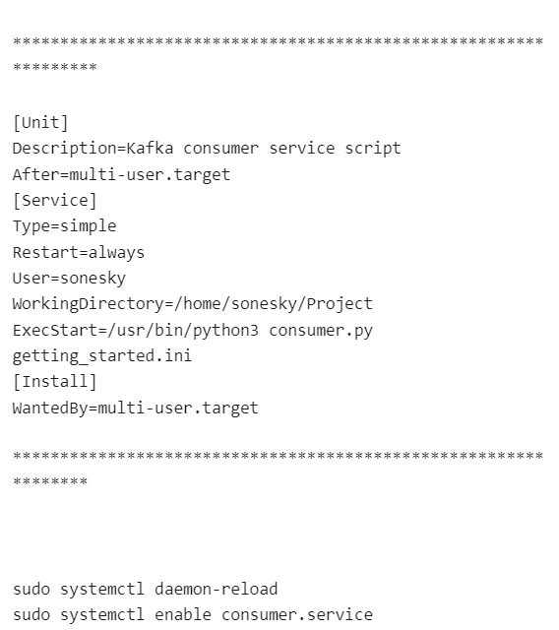



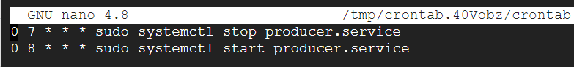

Susan

Slide 5
THE PIPELINE

Slide 6



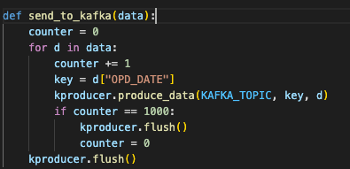
P
C
Data Transportation
Prachi

Slide 7

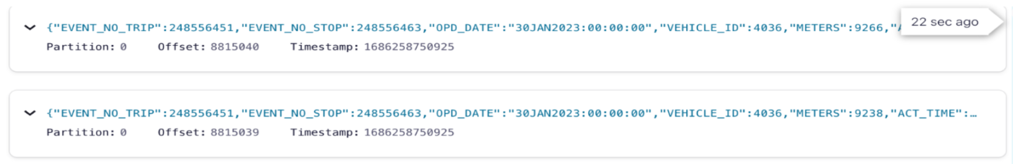
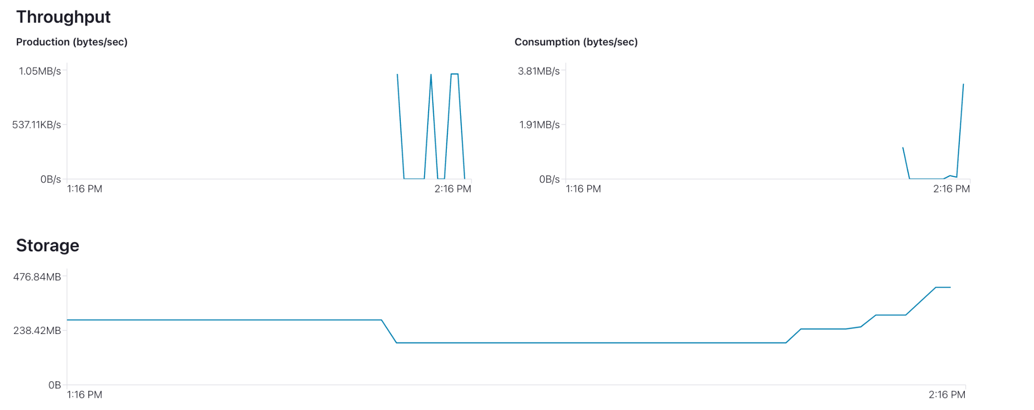
CONFLUENT
Prachi

Slide 8
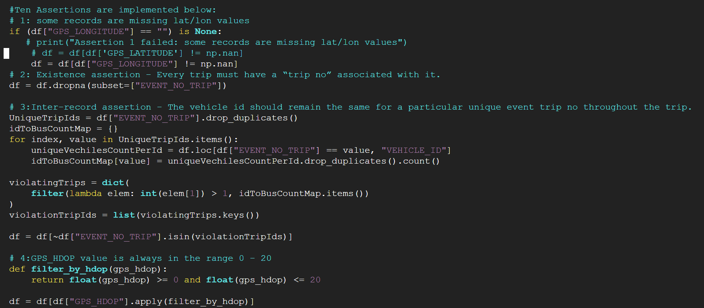
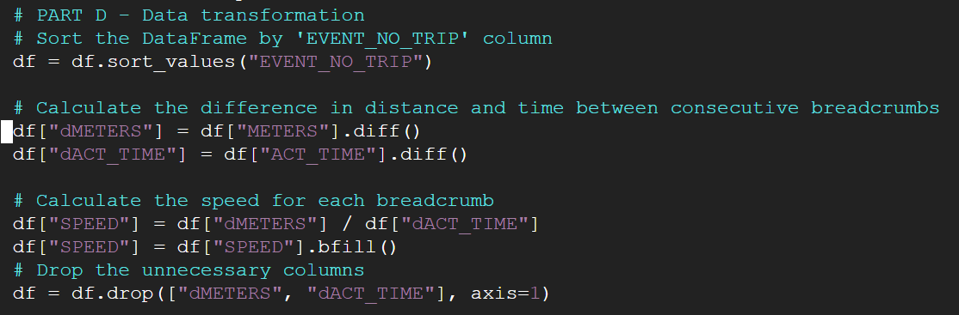
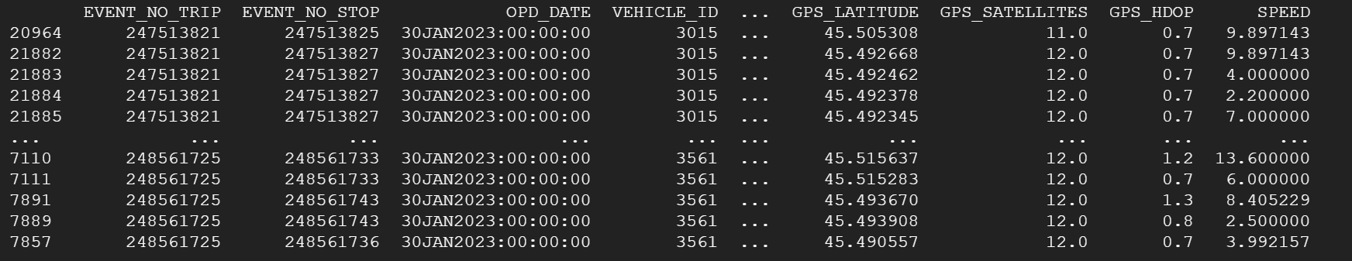
DATA VALIDATION & TRANSFORMATION
Columns we have after the validations and transformation
Prachi

Slide 9

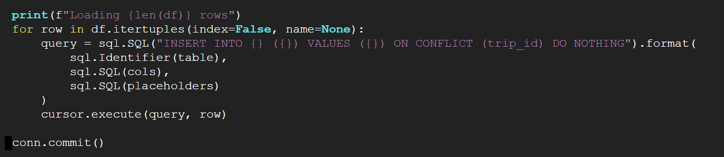
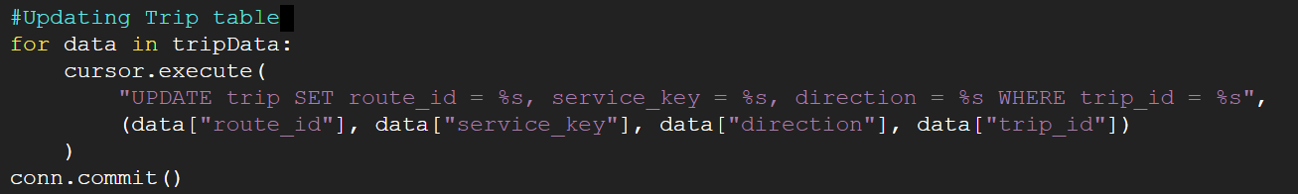
P
C
storage
DATA STORAGE
Prachi

Slide 10
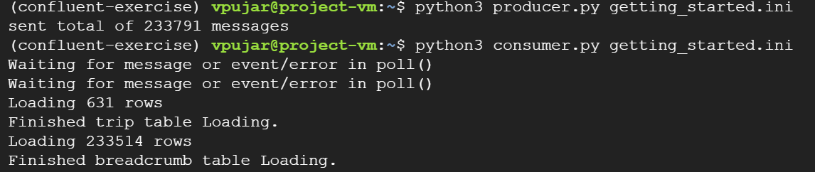
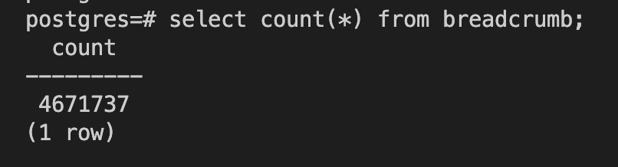
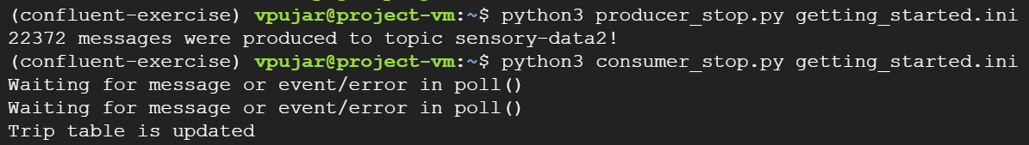
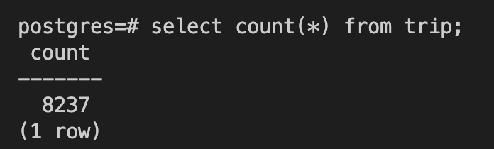
QUANTITY AND STORAGE
Breadcrumb data
Stop Event data
Vijayalaxmi

Slide 11
VISUALIZATION

Slide 12
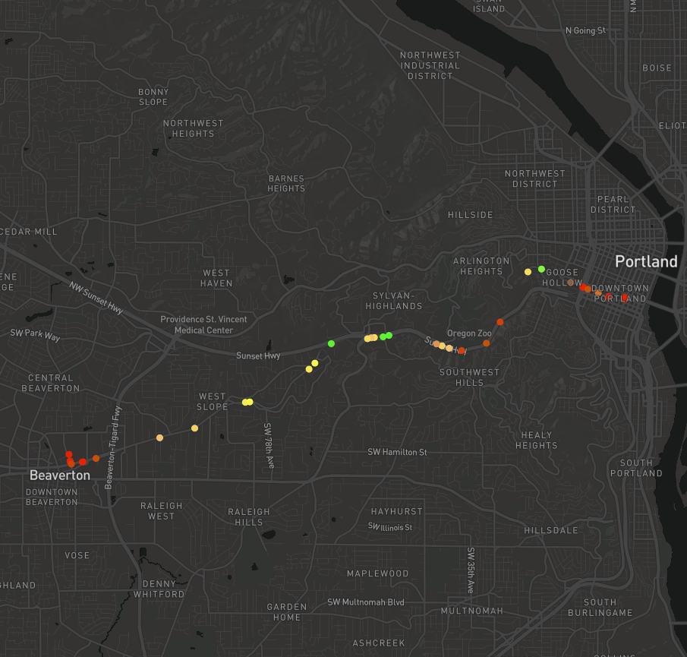
Tunnel Crossing
One trip
On route 58
Which crosses US 26 tunnel
On weekday schedule
On Date 2023-01-20
Starting at 15:15:16
Ending at 15:44:56
Vijayalaxmi

Slide 13
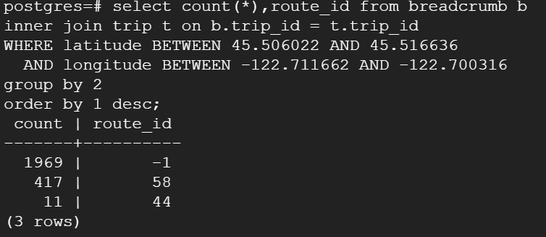
Find a route crosses US26?
Vijayalaxmi

Slide 14
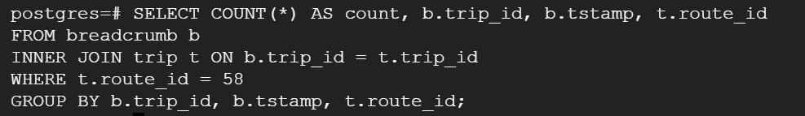
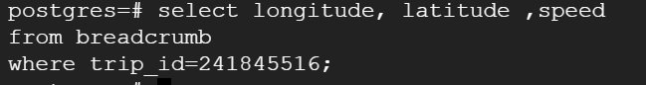
Find a trip from Route 58
Collect the data points
Vijayalaxmi

Slide 15
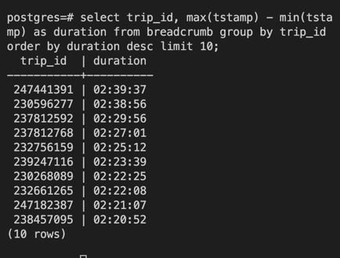
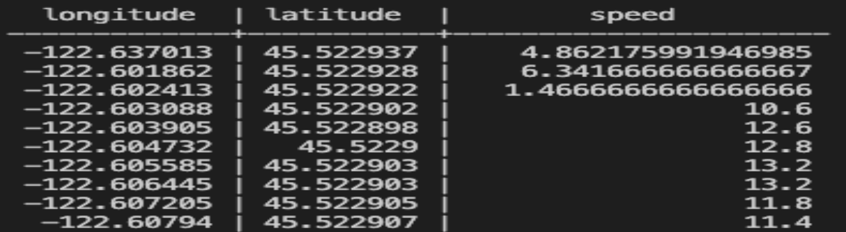
2. Longest trip
Collect the data points
Chitradevi

Slide 16
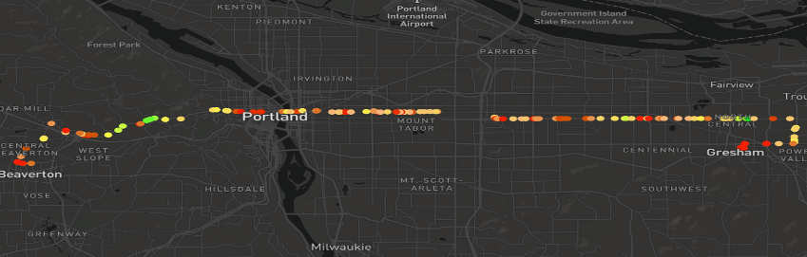
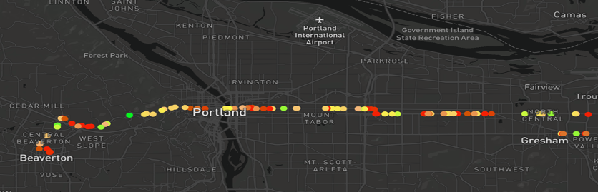
Trip_id : 247441391(First longest trip)
Date: Jan 29,2023
Start_time: 13:27:25
End_time: 16:07:02
Duration: 02:39:37
Trip_id = 230268089(Second longest trip)
Date: Jan 2,2023
Start_time: 11:34:08
End_time: 13:56:33
Duration:02:22:25
Chitradevi

Slide 17
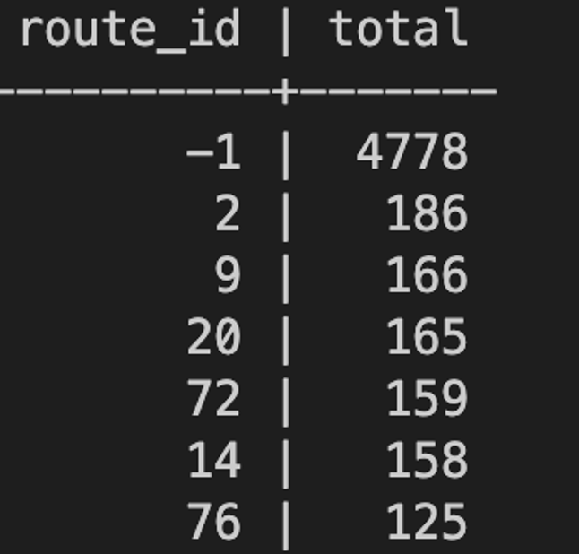
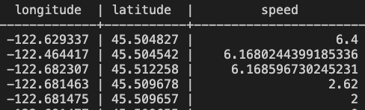
3. Most Popular route
Collect the data points
Chitradevi

Slide 18
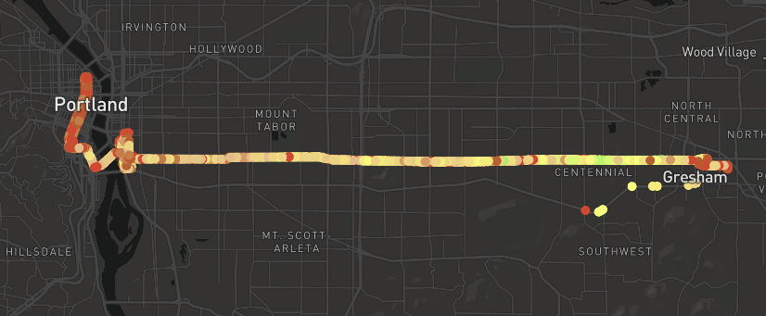
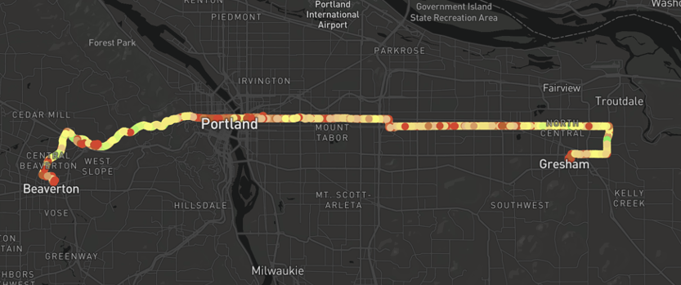
Route_id: 2
Route_id: 20
Chitradevi

Slide 19



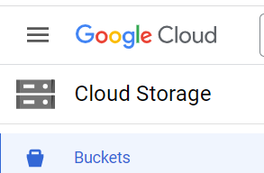
Future Work:
-Auto-send backup file records to Cloud Storage
-More validations
-Auto fix invalid data
Chitradevi

Slide 20

THANK YOU!
HH
Dr. Bruce Irvin
Mina Vu
TriMet

